Slide 1
The Psychology of Start-up Teams
Composing Start-up Teams
Professor Lindred L. Greer April 18, 2016
Notes:
What were the key take-aways from last class? What did you learn that you could apply to a start-up you are in or studying?
https://www.youtube.com/watch?v=gKftzAbfcGU

Slide 2
Individual differences in Start-up teams
Start-up Team Formation
Notes:
When you start to form a team around you in your start-up, who should you choose to be in your team? Why?

Slide 3
Agenda for Today
1
Choosing the Dream Team for Your Start-up
2
Hiring in Start-ups
3
Onboarding in Start-ups

Slide 4
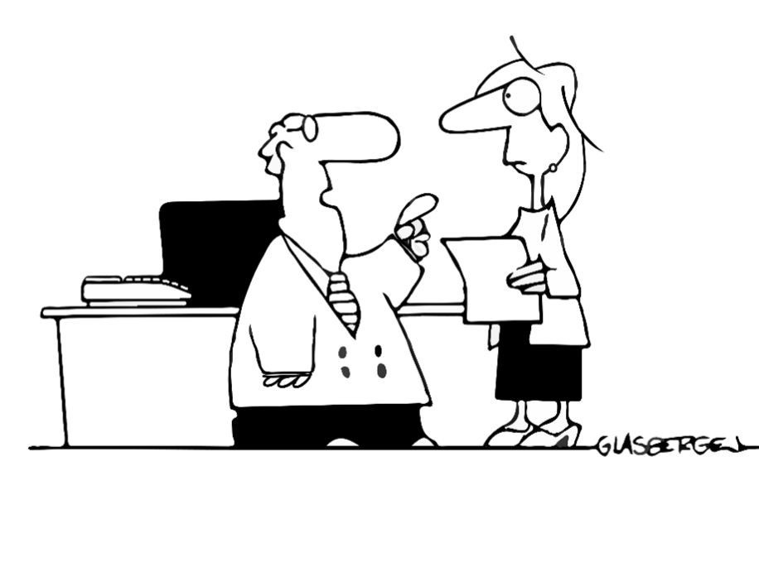
01 Choosing the Dream Team for Your Start-up
“We need to focus on diversity. Your goal is to hire people who all look different, but think just like me.”

Slide 5














hiring the dream team
Common Mistakes
Making a hire based on your “gut”
Only hiring based on company needs
Not hiring based on company needs

Slide 6

Homogeneity in Start-ups
Notes:
Birds of a Feather Flock Together:
When founders choose their team, they often chose members based on such heuristics as proximity, past experience, or social ties
3 REASONS WHY: EFFECIENCY, VALIDATION, FRIENDSHIP

Slide 7
Effect OF Homogeneity on groups
Perceived Effectiveness
% Groups Accurate
Socially similar
Socially dissimilar
Socially similar
Socially dissimilar

Slide 8




Importance of Diversity in START-up Teams
What are the top 3 reasons given by executives for the importance of diversity?
Better utilization of talent
Better understanding the diversifying marketplace
More creativity and problem solving

Slide 9

Dimensions of diversity
Gender
Race
Age
Ethnicity
Abilities
Geographic Location
Beliefs
Work Experience
Family
Appearance
Married Status
Veteran Status
Education
Habits
Relationships
Sexual Orientation
Styles
Parental Status
Business Unit
Work Field
Work Location
Job Experience
Mgmt. Leadership Style
Career Orientations
Work/Family Balance
Vendor
Customer
Supplier
Department
Job Classification
Administrative
Exempt
Non-exempt
Technical
Union Affiliation
Contractors
YOU

Slide 10
WHEN DIVERSITY HELPS Start-ups
Multiple meta-analyses have now shown that the effects of team diversity are contextually driven
Diversity helps when:
The differences are complementary and bring unique perspectives on the task
There is an overarching common goal and identity and shared set of values
The team is willing to believe in the value of diversity

Slide 11
WHEN DIVERSITY BACKFIRES in STARTUPS
Demographic Faultlines:
Hypothetical dividing lines that may split a team into subgroups
Bottom line: Faultlines hurt collaboration in teams!
Female,
marketing
Female,
engineering
Female,
marketing
Female,
engineering
Faultline
Male,
marketing
Male,
engineering
Male,
marketing
Male,
engineering

Slide 12












Take-aways: Who to hire for your start-up
Functional diversity is good for performance
Beckman, Burton, and O’Reilly (2007) found that functional diversity helped young high-tech firms (N=161) get funding and complete IPOs
But look beyond expertise fit; also consider personality and value fit
Every team needs stars AND team players
Helpful individual traits in start-ups:
Experience
Flexibility and tolerance for ambiguity
Risk-tolerance
Willingness to mentor and be a team player
Resilience
Commitment to hard work
Self-starting
Passion for your business
...and according to recent research, don’t shy away from pessimism! Start-ups are often over-confident!
Notes:
Beckman, Burton, and O’Reilly (2007) 161 young hightech firms. Team functional heterogeneity, prior management experience, prior affiliation diversity, and new member entrances help firms gain VC and complete IPOs.

Slide 13

Diversity: Describe Your Start-up
What are the most visible forms of diversity (or similarity) in the start-up?
Are there fault lines?
How is the team composition influencing interactions in the start-up?
What can the start-up do in order to improve its composition or the culture around it?

Slide 14
02 Hiring in Start-up Teams

Slide 15

Hiring the dream team
Thomas Goetz, CEO and Co-founder, Iodine
“Many entrepreneurs describe recruiting as the most difficult, most important thing they do. Their stories typically involve unicorn chases, the quest for candidates worthy of their company.
But few admit to the other side of that equation: how hard it is to persuade the best prospects to stake their careers on your idea.
In other words, it's one thing to find those unicorns. But it's quite another to talk them into following you into the thicket.”
Notes:
http://www.health2con.com/tv/files/thumbnail_2_3d18a095_9_v1-405x229.jpg

Slide 16

Hiring the dream team for your start-up
Tips and Best Practices to Lure Unicorns:
Sell your mission (your passion!) and why it matters
01
05
Offer incentives – money, prestige, flex work, etc
02
04
Make the most of the start-up culture
Facilitate personal development
03
Promote the ability to define and craft role and to grow with the company

Slide 17
03 onboarding in Start-up Teams

Slide 18







Now you have them: What then? Onboarding new people into your start-up
1 in 6 people quit or consider quitting due to ineffective onboarding
Should I stay or go?
Notes:
Zappos is another onboarding standout. They devote a full month to new employee orientation, which includes cultural immersion, team building, and how to deliver Wow! service. At the end of the orientation period, new hires who feel they are not a good cultural fit are offered $2,000 to quit--an important indicator of how Zappos values people’s time and protects the company culture.

Slide 19
Onboarding new people into your start-up
Common Mistakes
Companies
$0 on onboarding
Mistake #1
Not investing in onboarding! 35% of companies spend $0 on onboarding!
35%
Other mistakes
Not structuring the onboarding process
Introducing job without introducing company culture
Overpromising
Setting unrealistic expectations
Failure to communicate
Being vague
Not setting times to check back in and communicating important milestones
Notes:
Zappos is another onboarding standout. They devote a full month to new employee orientation, which includes cultural immersion, team building, and how to deliver Wow! service. At the end of the orientation period, new hires who feel they are not a good cultural fit are offered $2,000 to quit--an important indicator of how Zappos values people’s time and protects the company culture.

Slide 20
Onboarding new people into your start-up
Tips and Best Practices:
Celebrate their arrival
Establish time points to check in
Have a structured process
New Hire
The little things matter (supplies, introductions, etc.)
Make room for safe failure
Assign a mentor
Set expectations
Notes:
Zappos is another onboarding standout. They devote a full month to new employee orientation, which includes cultural immersion, team building, and how to deliver Wow! service. At the end of the orientation period, new hires who feel they are not a good cultural fit are offered $2,000 to quit--an important indicator of how Zappos values people’s time and protects the company culture.
Set exepcations:
Clarify role
Establish job expectations
Identify individual objectives
Align employee and company goals

Slide 21
Take-Aways
what to keep in mind when forming your start-up team
embrace diversity, but common values
To get value from diversity, build bridges: Make sure everyone in the same team is on the same page & build team identity
Unique cultures and strong visions lure unicorns
Well thought-out onboarding helps you keep unicorns

Slide 22
Start-up Team Formation

Slide 24
Thank you! Please feel free to reach out with any questions LGReer@stanford.edu
lgreer@stanford.edu

